Slide 1
ENSE 400 Vlog 2
SoundByte
Brandon Clarke, Mason Lane, Jiwoun Kim
15/11/2020

Slide 2
What We’re Doing
Our team will provide creators & hobbyists with a tool that prescribes audio files to complement a given song when mixing. The goal is to improve the workflow of artists while being a utility for DJs in the future.

Slide 3
Roles and Responsibilities
Brandon Clarke:
ML component. Science, Research, Development
Jiwoun Kim:
frontend design & development
backend development
Mason Lane
Scrum Master
backend/frontend architecture
backend/ML development

Slide 4
What Have We Been Up To?

Slide 5
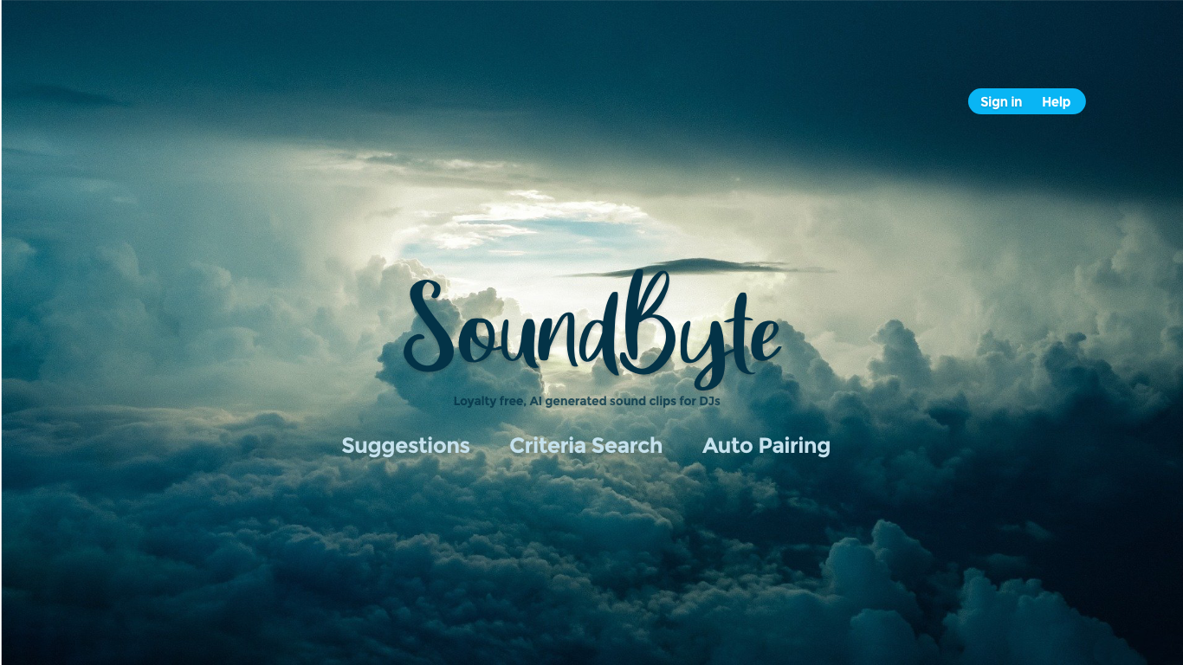
HiFis Landing Page

Slide 6
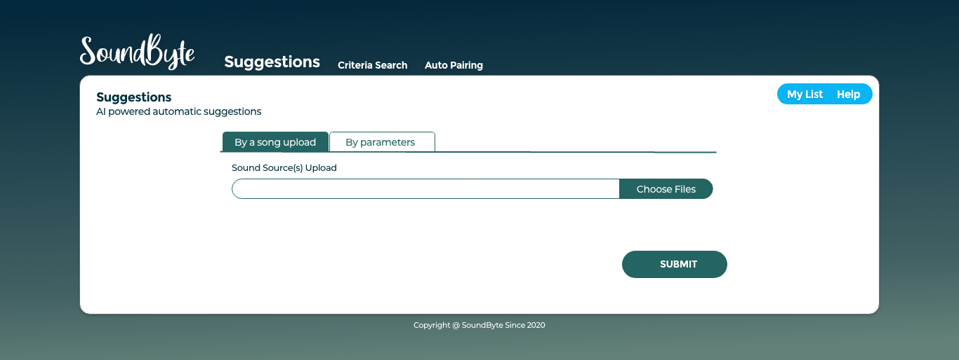
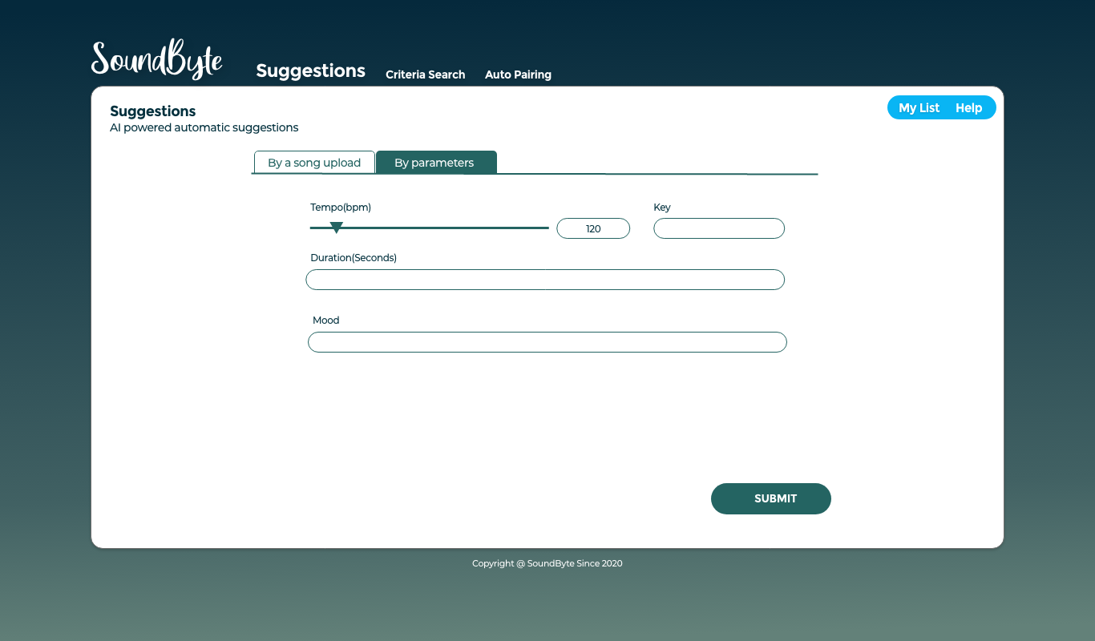
HiFis Suggestions options

Slide 7
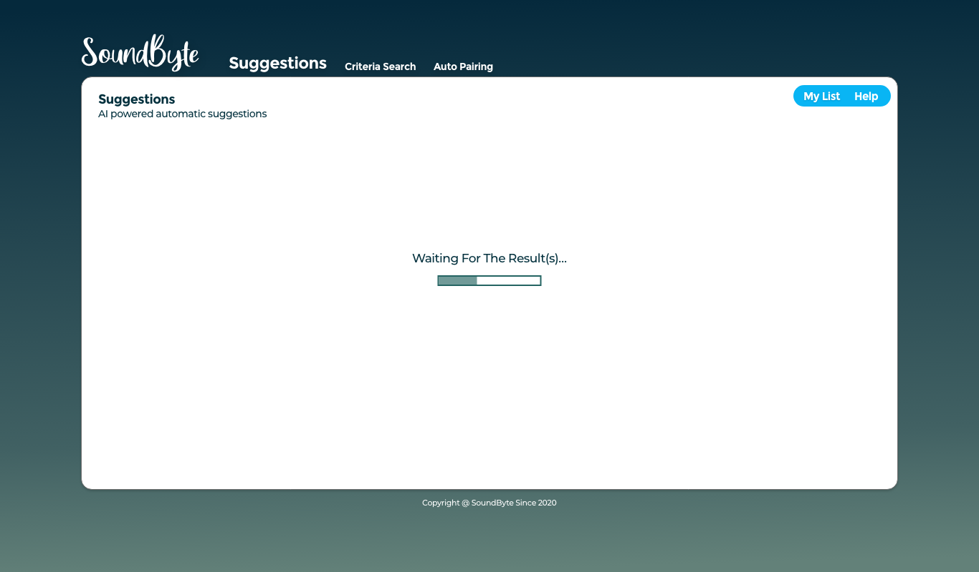
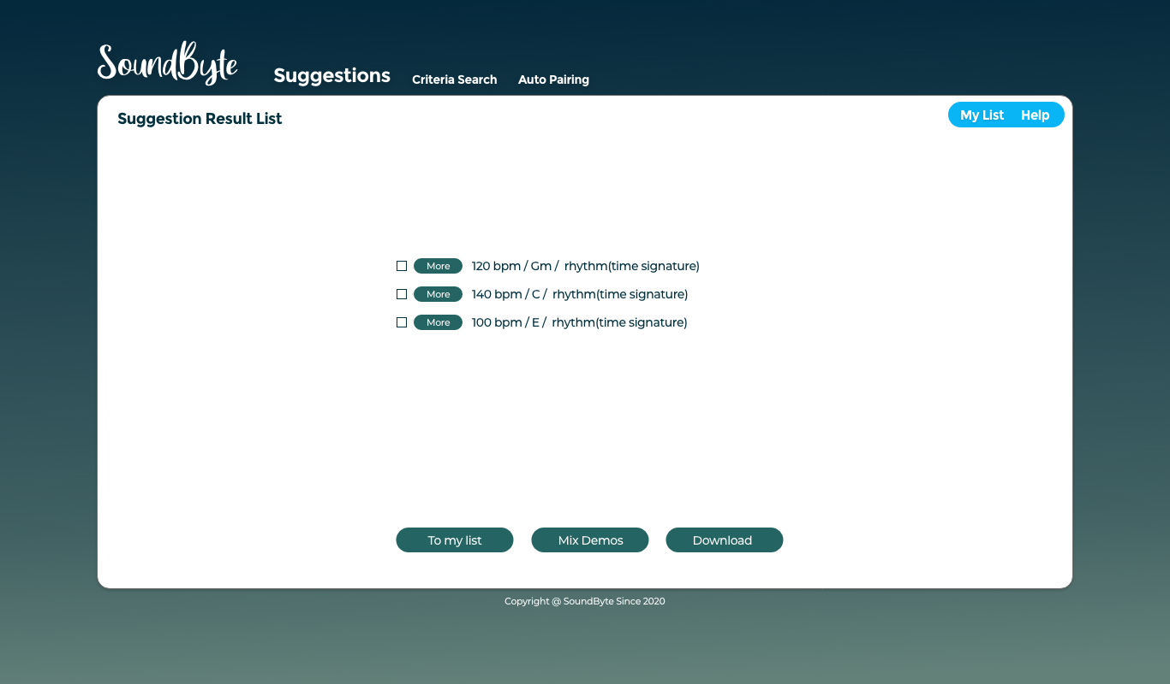
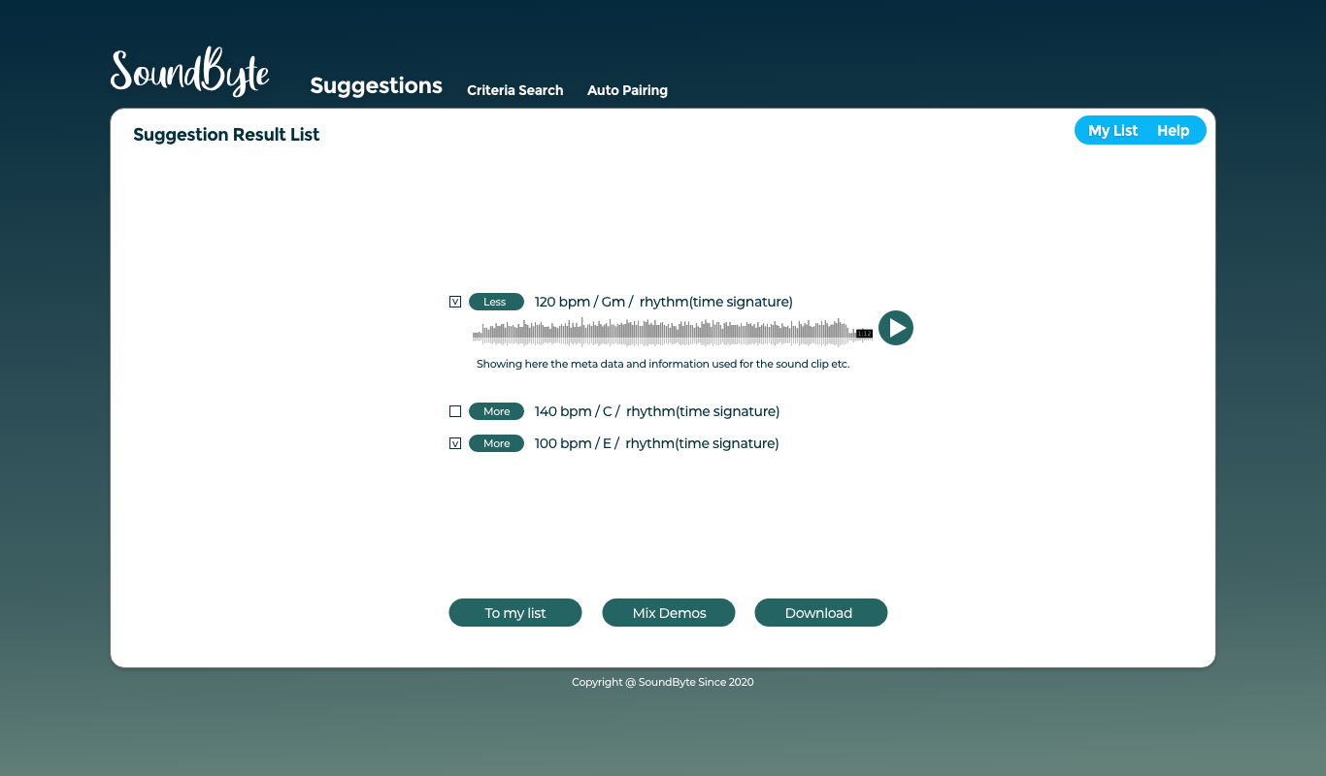
HiFis Results List(Suggestions)

Slide 8
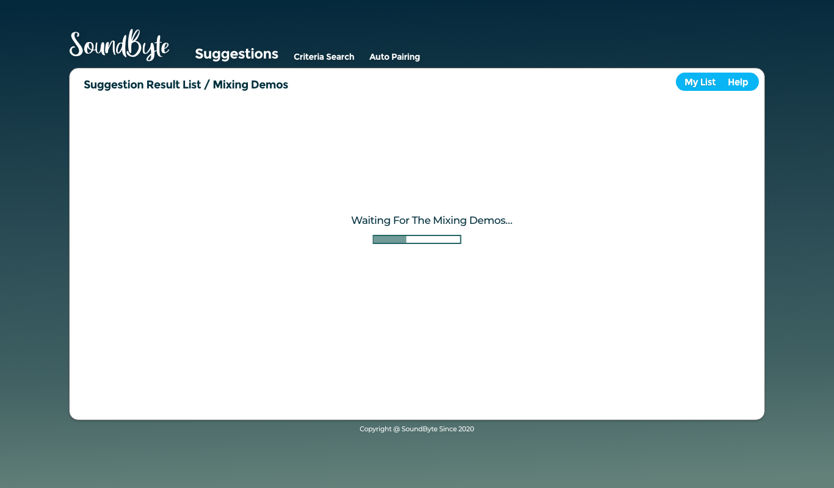
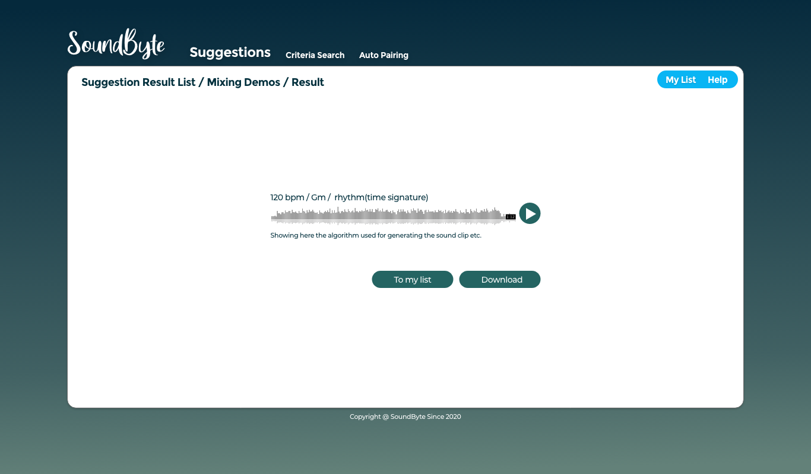
HiFis Mixing Demos(Suggestions)

Slide 9
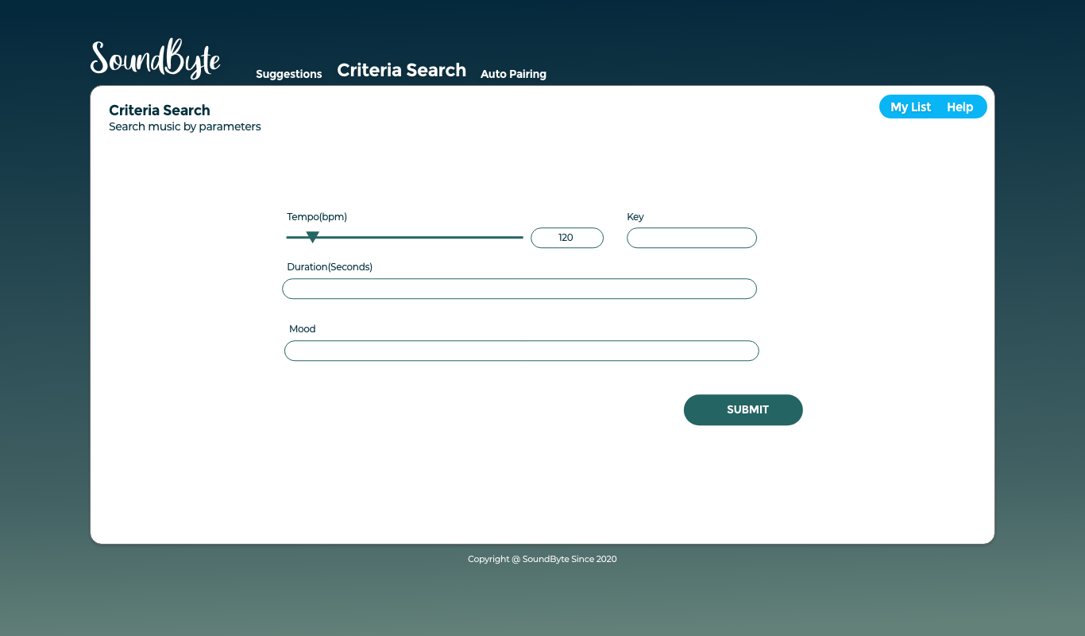
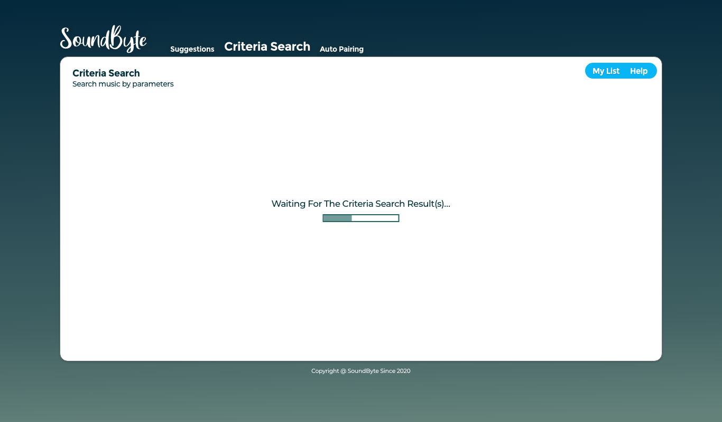
HiFis Criteria Search

Slide 10
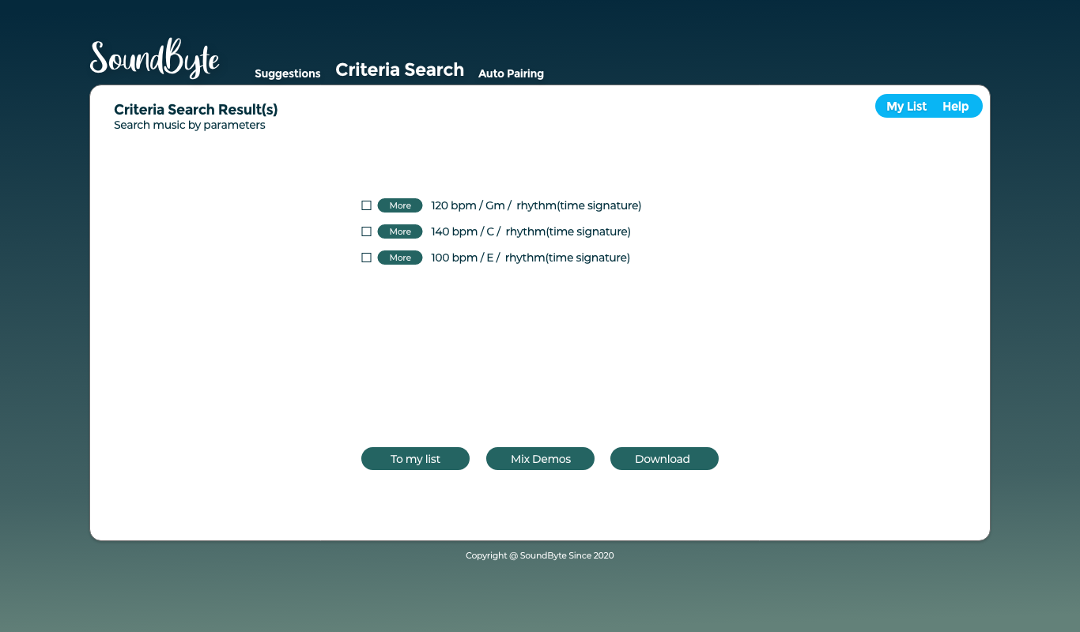
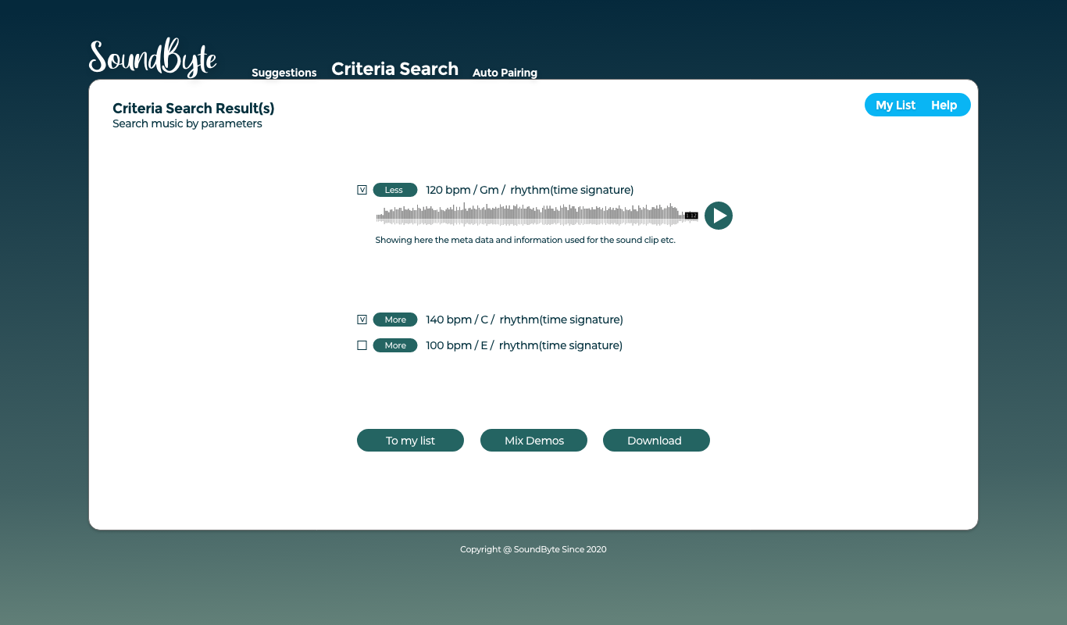
HiFis Search Results(Criteria Search)

Slide 11
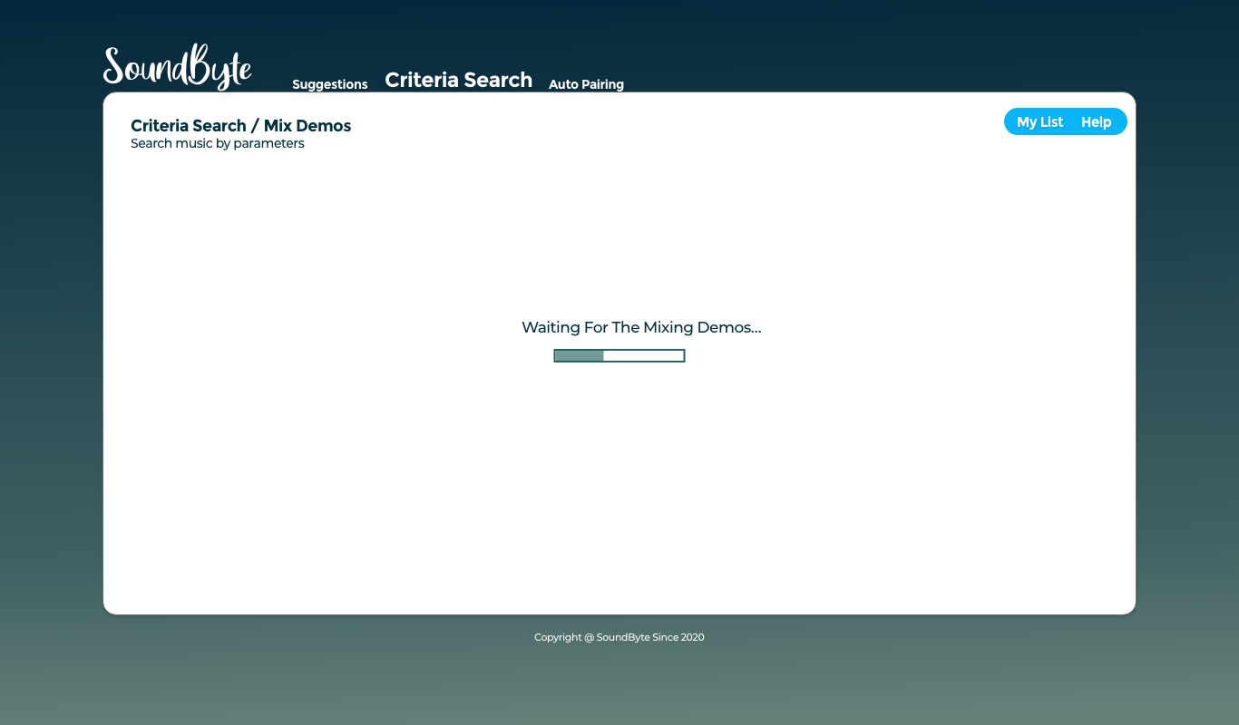
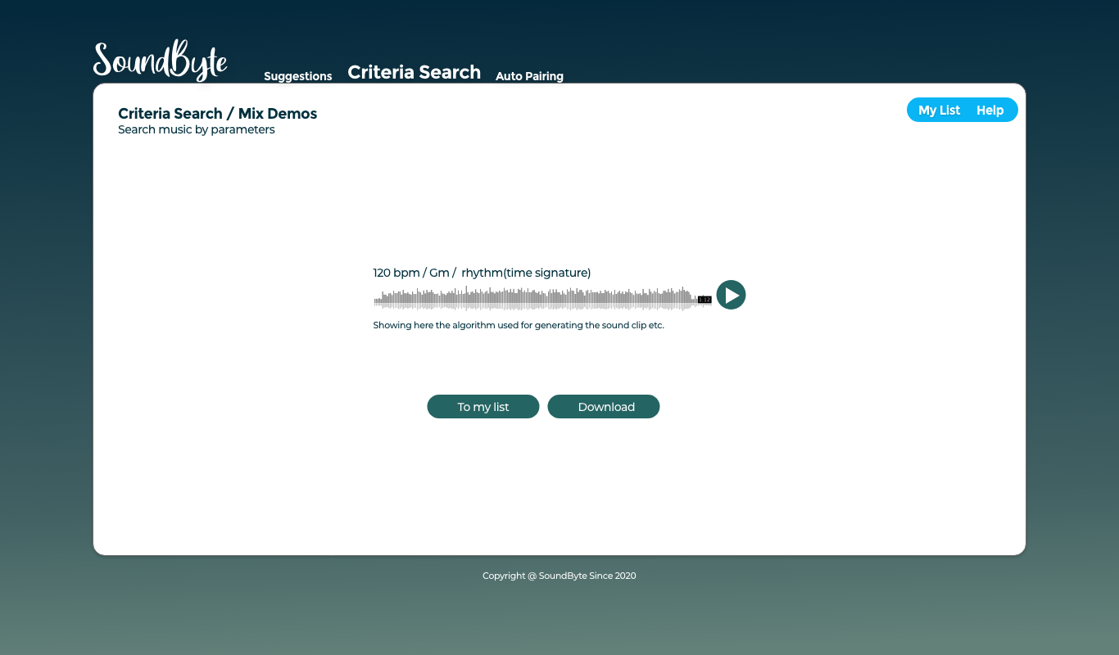
HiFis Mixing Demos(Criteria Search)

Slide 12
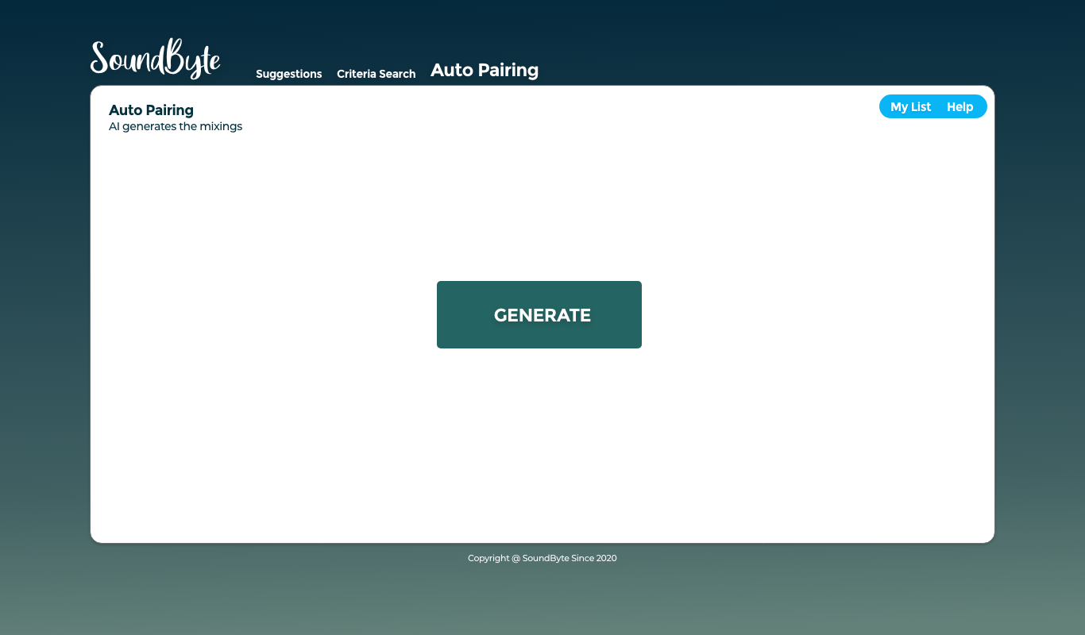

HiFis Auto Pairing

Slide 13
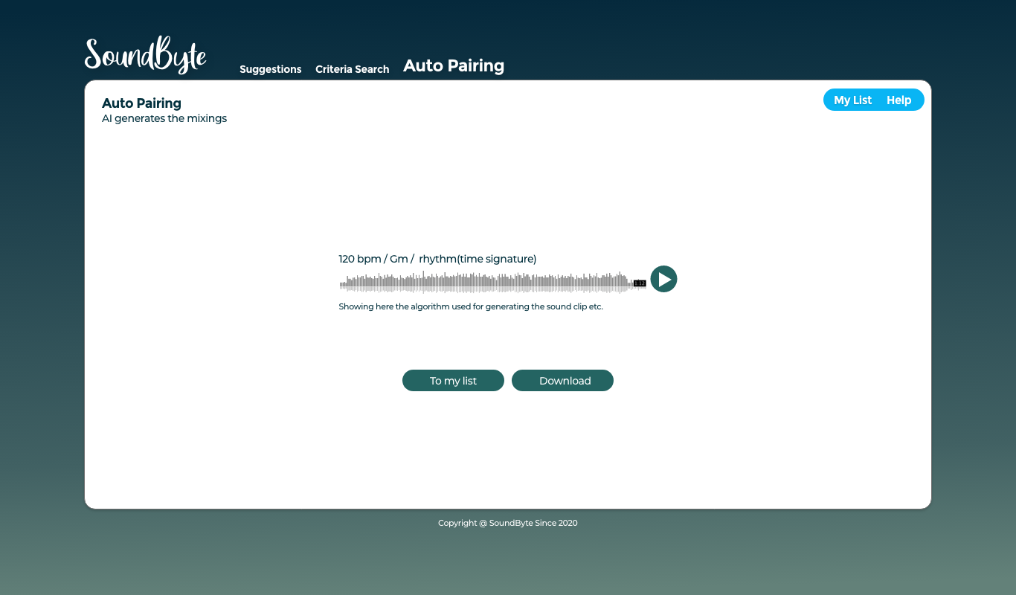
HiFis Auto Pairing(result)

Slide 14
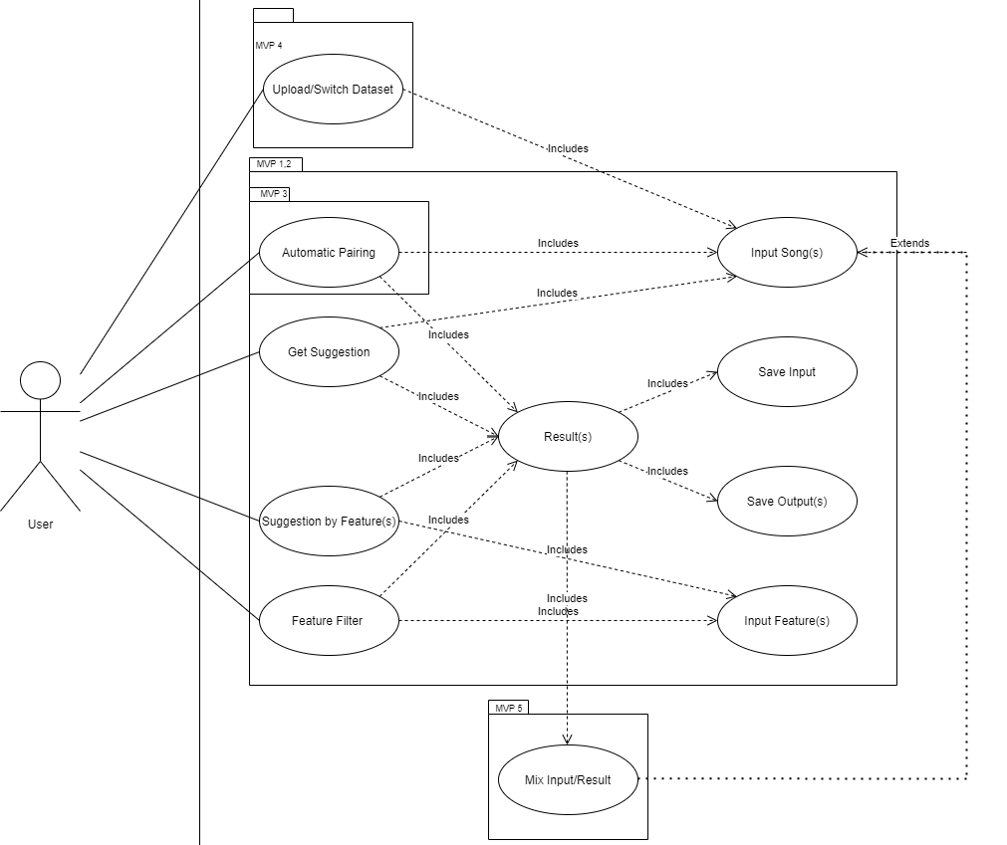
Architecture

Slide 15
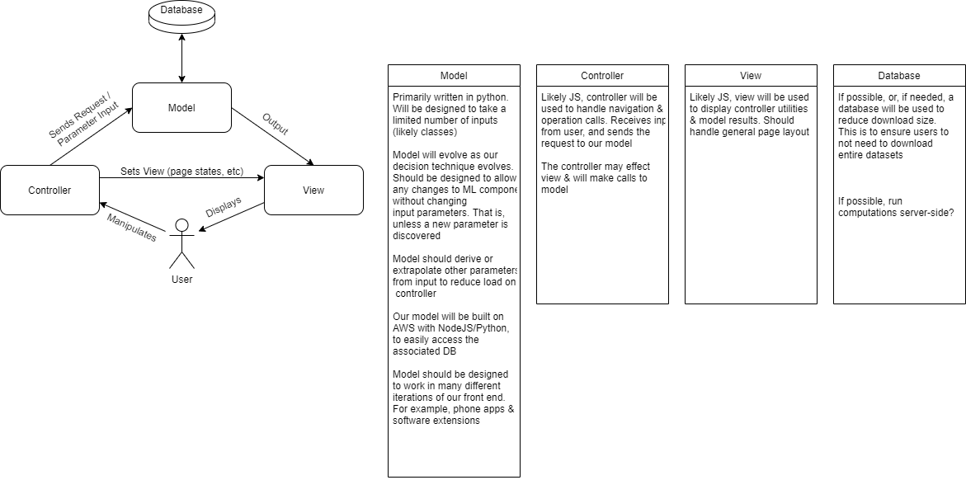
Architecture

Slide 16
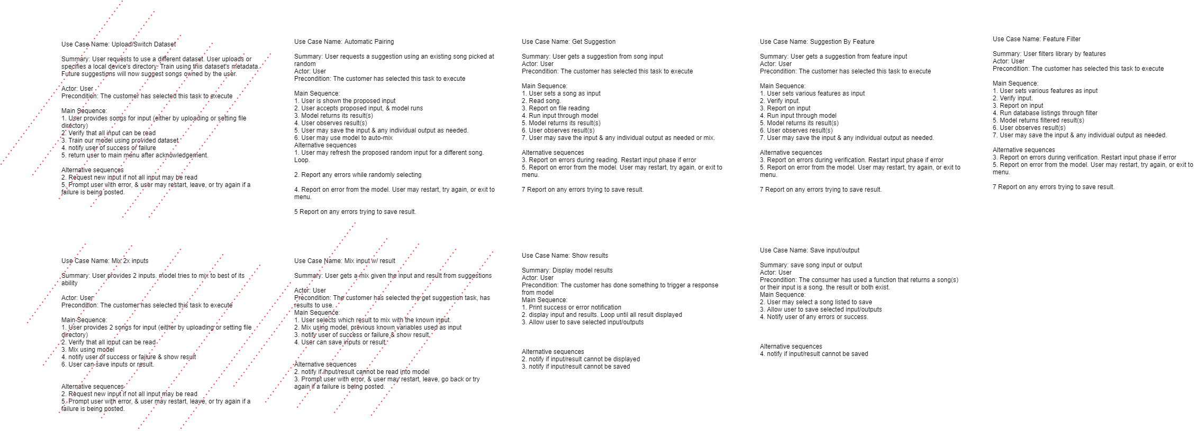
Architecture

Slide 17
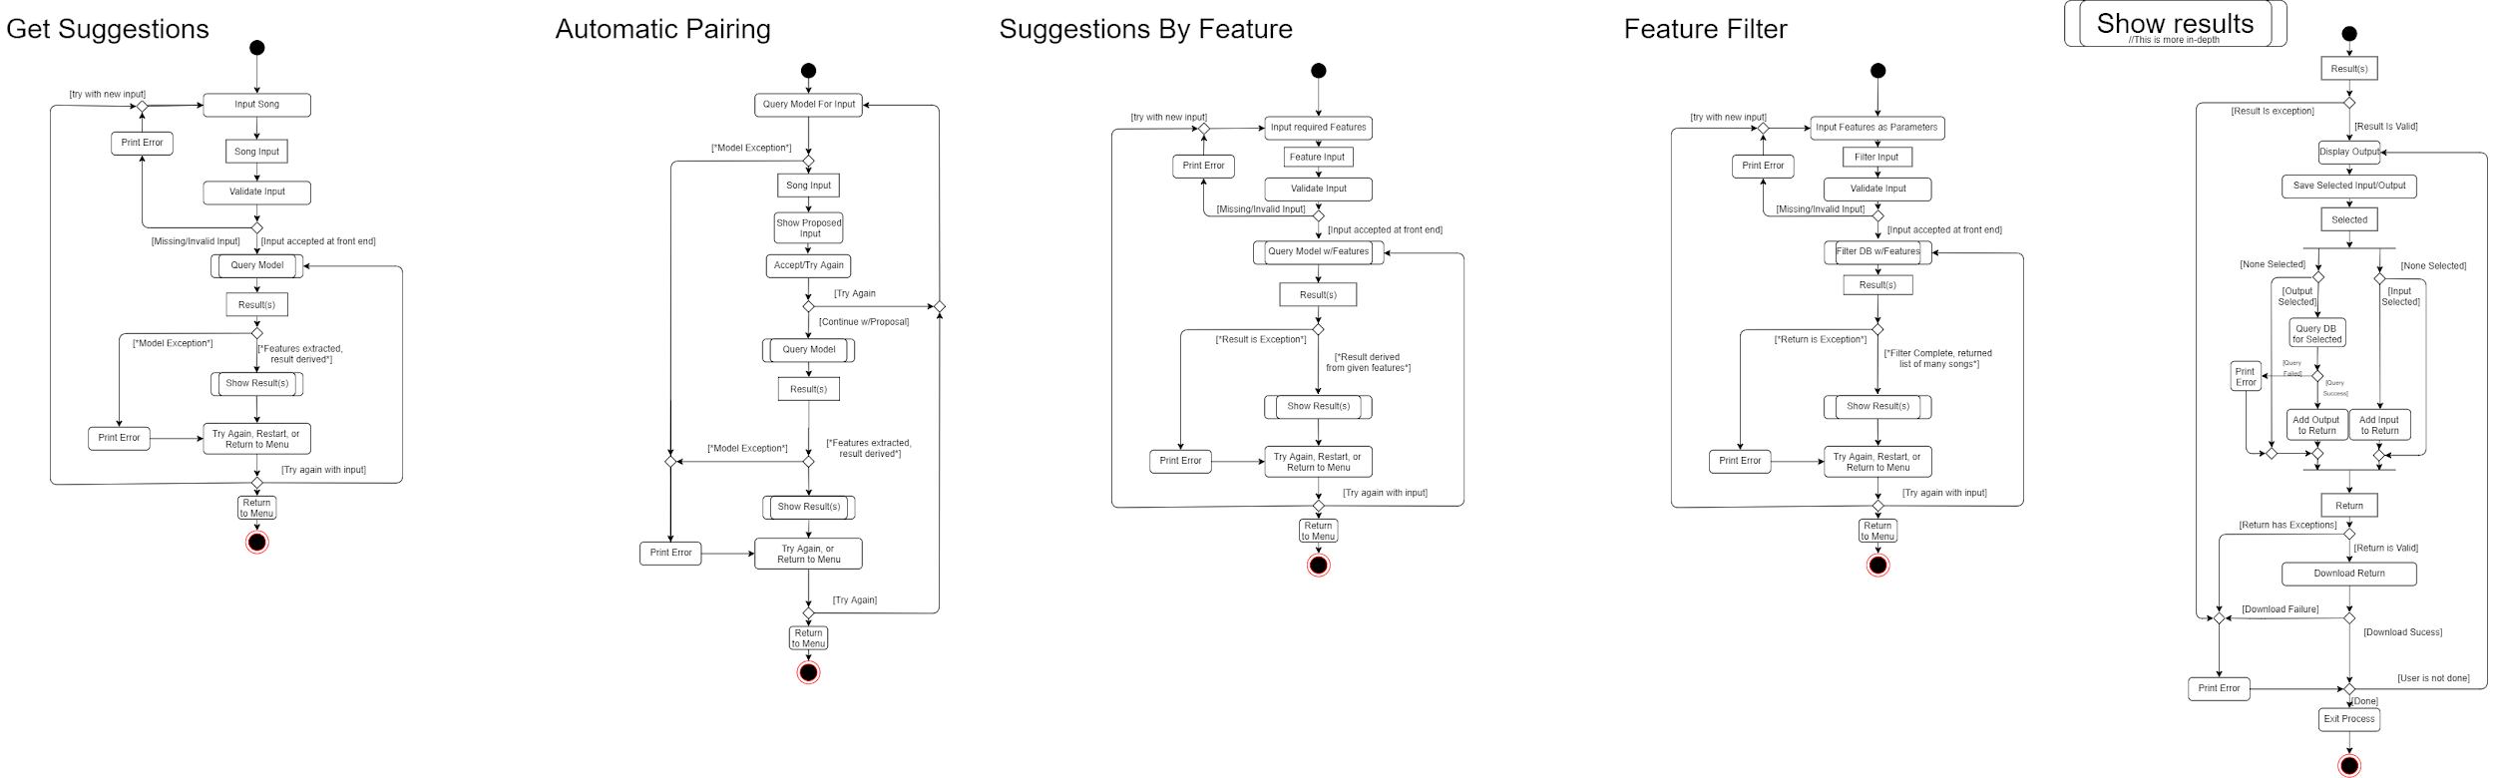
Architecture

Slide 18
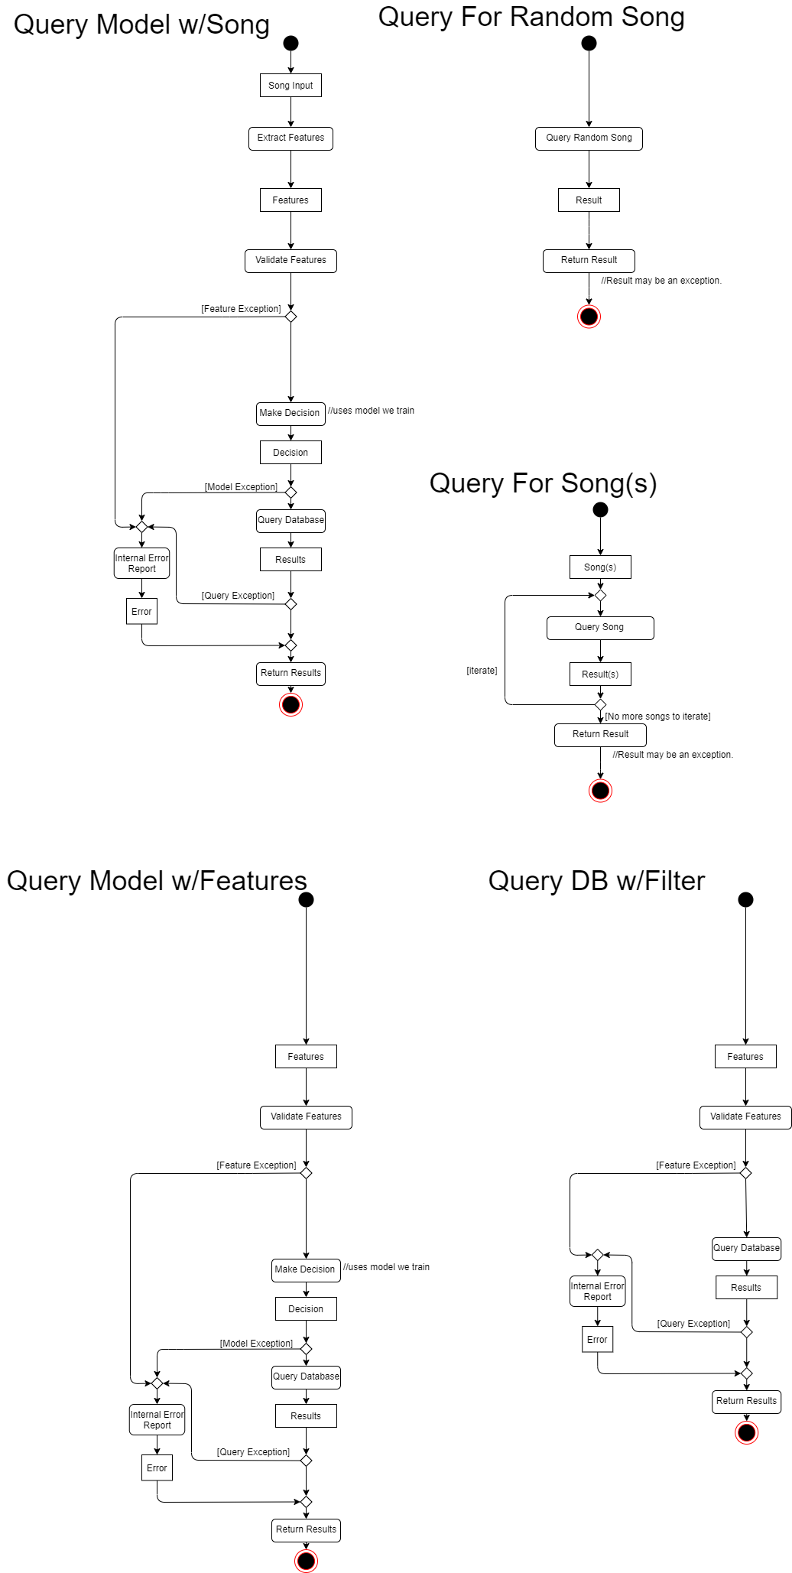
Architecture

Slide 19
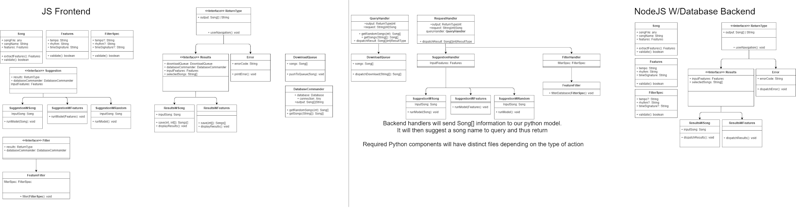
Architecture

Slide 20
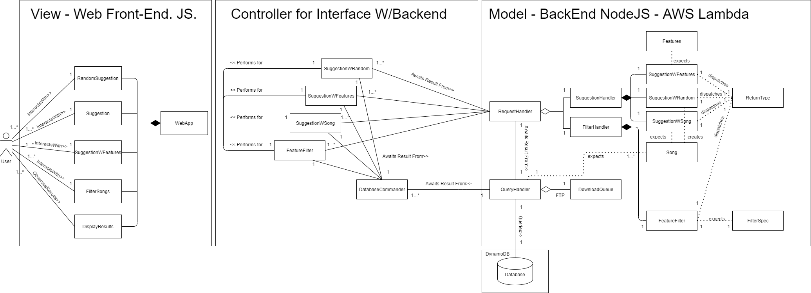
Architecture

Slide 21
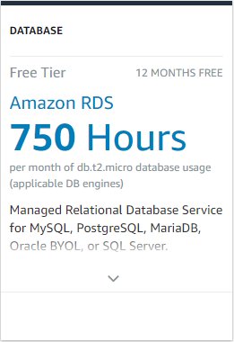
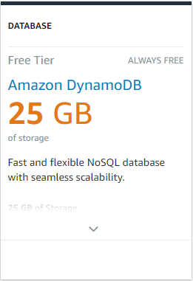
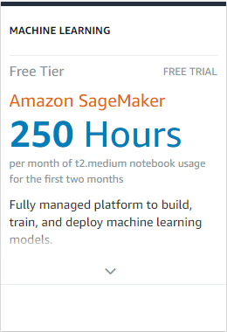
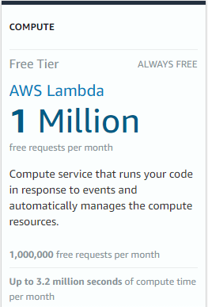
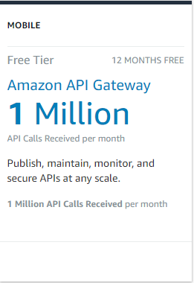
Technology
We’ve opted to use the following as our backend
AWS Lambda will handle requests. Mainly controller logic as it sends queries to the model/db.
We will be looking into AWS sagemaker, but may instead run our model from Lambda as well
Originally planned to use AWS Dynamo DB, but will instead opt for 12 months free of AWS RDS
To make communication between our front-end & AWS Lambda easier & secure, we will also consider leveraging AWS API Gateway.

Slide 22
Machine Learning
Dataset selected
Metadata such as key, mode, tempo, time signature
Metadata such as energy and danceability which may be fun to play with
Includes code for querying the dataset for one, many or all of the metadata associated with a song
Building a model
Contrasting and comparing with already available music suggestion algorithms
Fill the link between data and desired output

Slide 23
Whats next?
Brandon to continue work on ML component.
Extracting features,
training a model,
manipulating our dataset & deriving new features
Jiwoun & Mason to work on frontend/backend
Delving into our backend:
Setup AWS Lambda/RDS
Explore using AWS API Gateway & SageMaker
Handle simple requests from the front-end
Next, building a front-end to communicate with backend
Simple JS web-app.
Re-evaluate/define story mapping.
Create Dataflow/Communication Diagrams
Sequence Diagrams if needed.

Slide 24
What’s Missing/Behind?
Things To Remember
Early documentation needs a place on github. Notes must be organized into something digestible by faculty & stakeholders. UPDATE UPDATE UPDATE
Website/Landing for stakeholders & faculty. An area for you to meet us & the project as suggested by Tim
We have many design documents. However, architecture will change as we progress. If we change a document/class, we should remember to update past documents that lead to that conclusion

Slide 25
Group reflection
Do you feel you are on track?
We think we’ve caught up quite a bit. However, we need to really get started on building the foundational infrastructure.
Do you feel there are barriers to your success (if any)?
Start to finish, its our first time integrating all these components & techniques (duh - its capstone)
This is why we avoided using frontend frameworks like electron
Do you need any help going forward?
Assuring that our plans have as few holes as possible. IE: aws components are new to us. Are we missing something?
Any other questions or concerns?
Would love commentary on architecture. How are we doing?

Slide 26

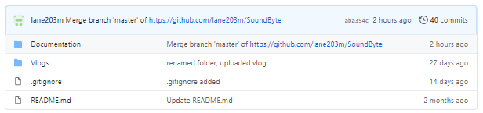
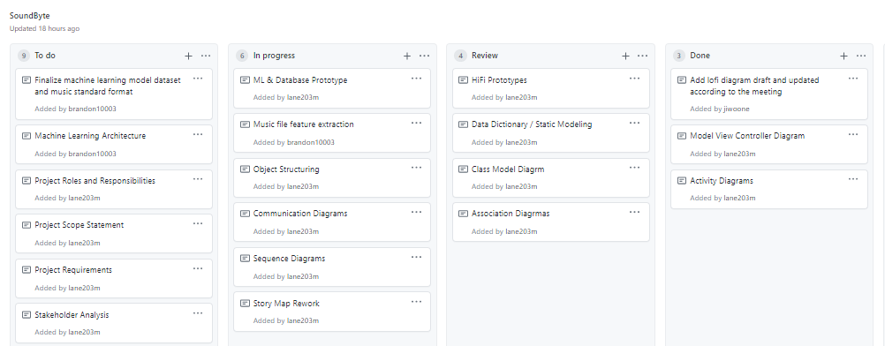
Github
https://github.com/lane203m/SoundByte

